Slide 1



Air Quality Prediction Platform
JOSEPH MOHAN
INFOSYS SPRINGBOARD 6.0

Slide 2
PROBLEM STATEMENT
Rising air pollution causing serious health crises
Existing platforms lack multi-model AI forecasting.
Limited public access to advanced prediction tools
Insufficient real-time pollution monitoring systems
High cost of professional environmental analytics

Slide 3

PROJECT OBJECTIVE
Develop AI/ML-powered air quality prediction platform
Implement multiple machine learning models
Create user-friendly visualization dashboard
Enable accurate 7-day air quality forecasting
Utilize OpenAQ and Kaggle as primary data sources

Slide 4

SOLUTION FEATURES
Real-time AQI monitoring with color-coded gauges
Multi-pollutant tracking and trend analysis
Smart model selection from 5 AI algorithms
Interactive 7-day forecasting display
Automated data quality assessment

Slide 5
TECHNOLOGY USED
Streamlit for web application framework
Plotly for interactive data visualization
Scikit-learn and TensorFlow for ML models
Pandas and NumPy for data processing
Statsmodels and Prophet for time series

Slide 6
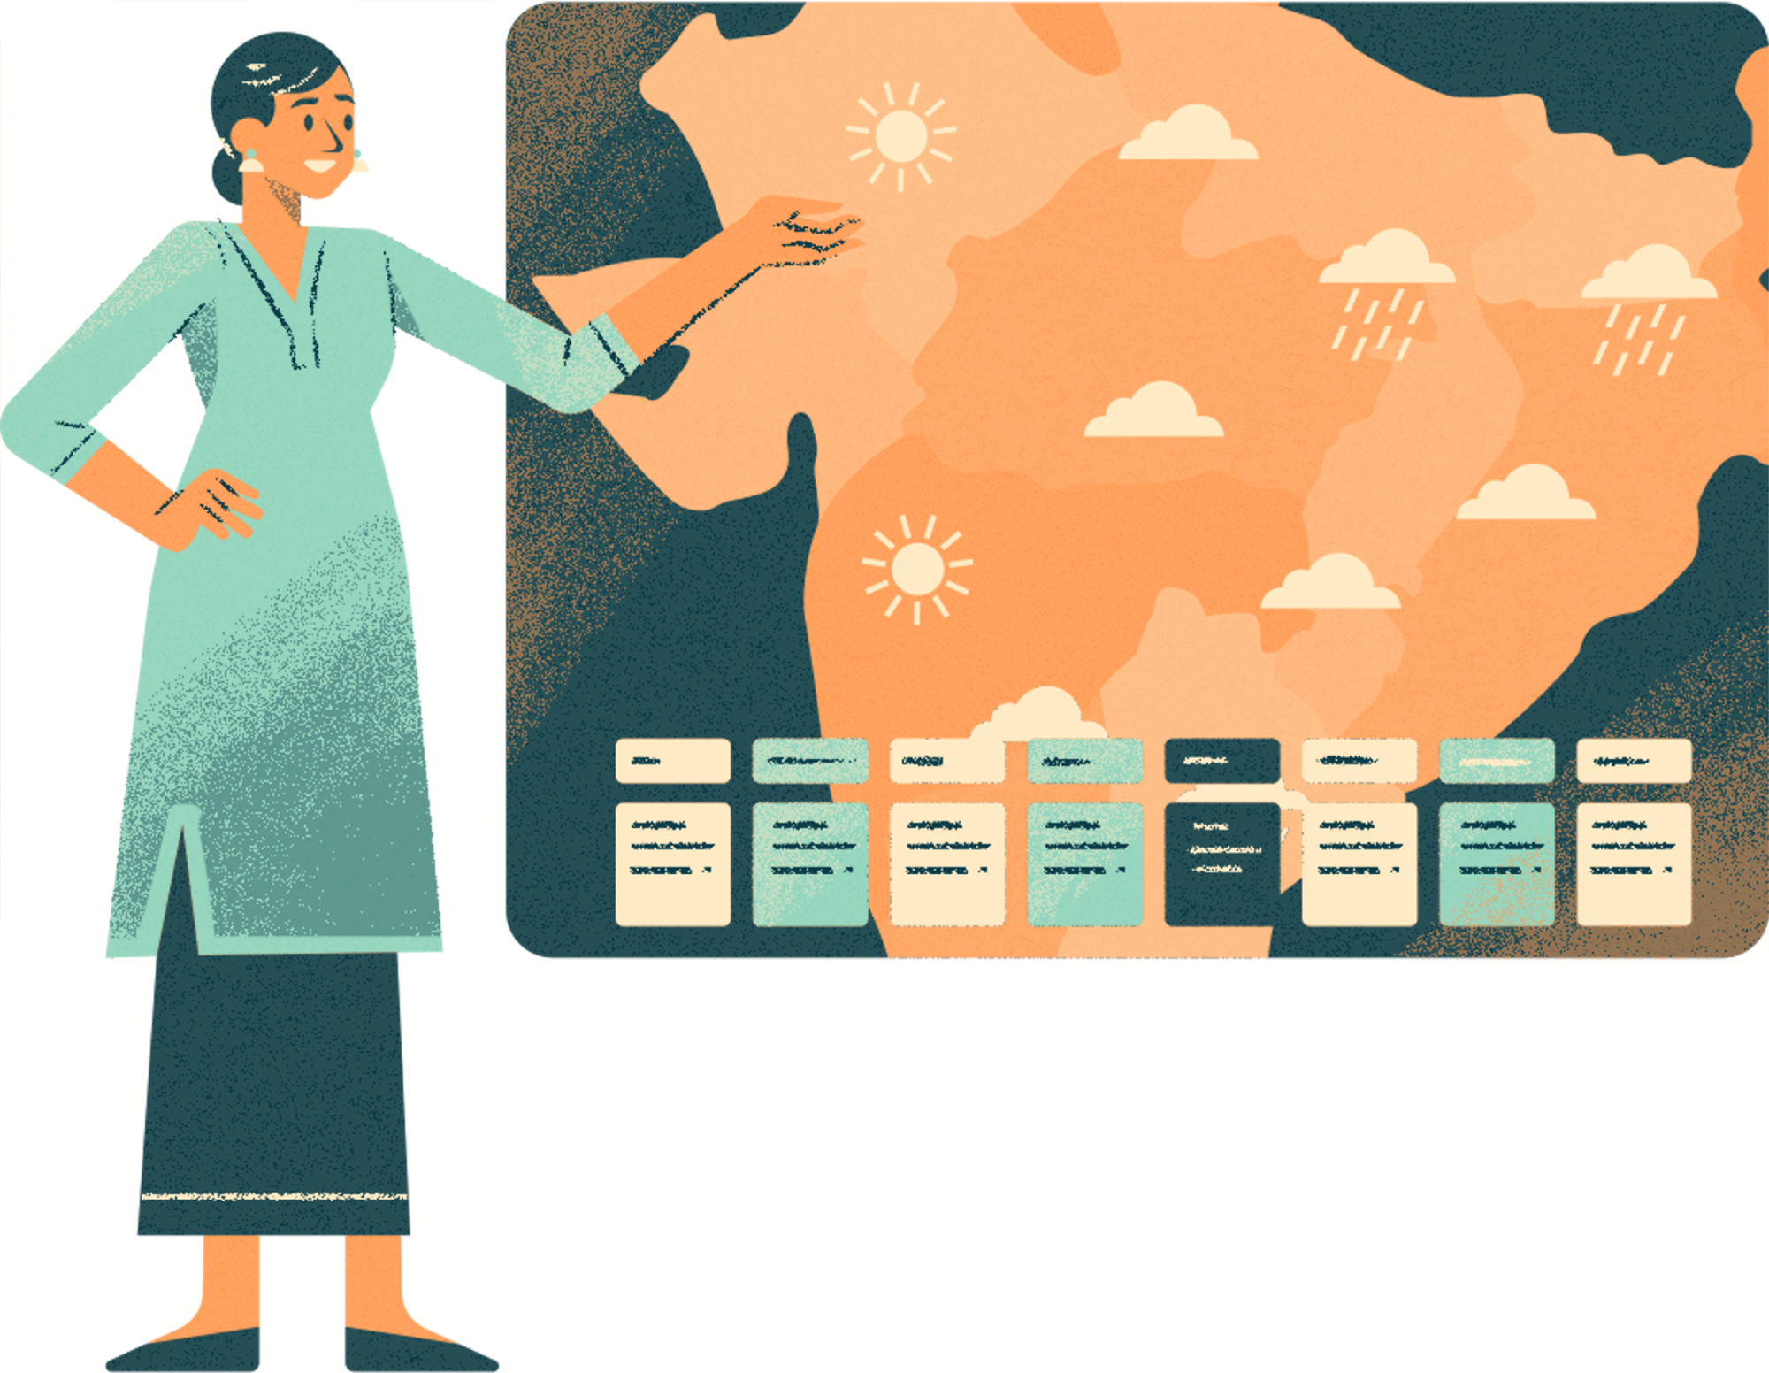
DATA SOURCES & PROCESSING
OpenAQ API: Real-time global air quality data
Kaggle Datasets: Historical pollution records
Multiple Countries: US, India, China, Europe coverage
Real time data validation and cleaning
Missing data imputation techniques
15+ Pollutants: PM2.5, PM10, O3, NO2, SO2, CO

Slide 7


AI/ML MODELS
ARIMA for statistical time series forecasting
Prophet for seasonal pattern recognition
LSTM neural networks for deep learning
Random Forest for ensemble predictions
Linear Regression for baseline modeling

Slide 8
PERFORMANCE METRICS
RMSE for prediction accuracy
MAE for error measurement
R² score for model fit quality
Automated model comparison
Real-time performance tracking

Slide 9
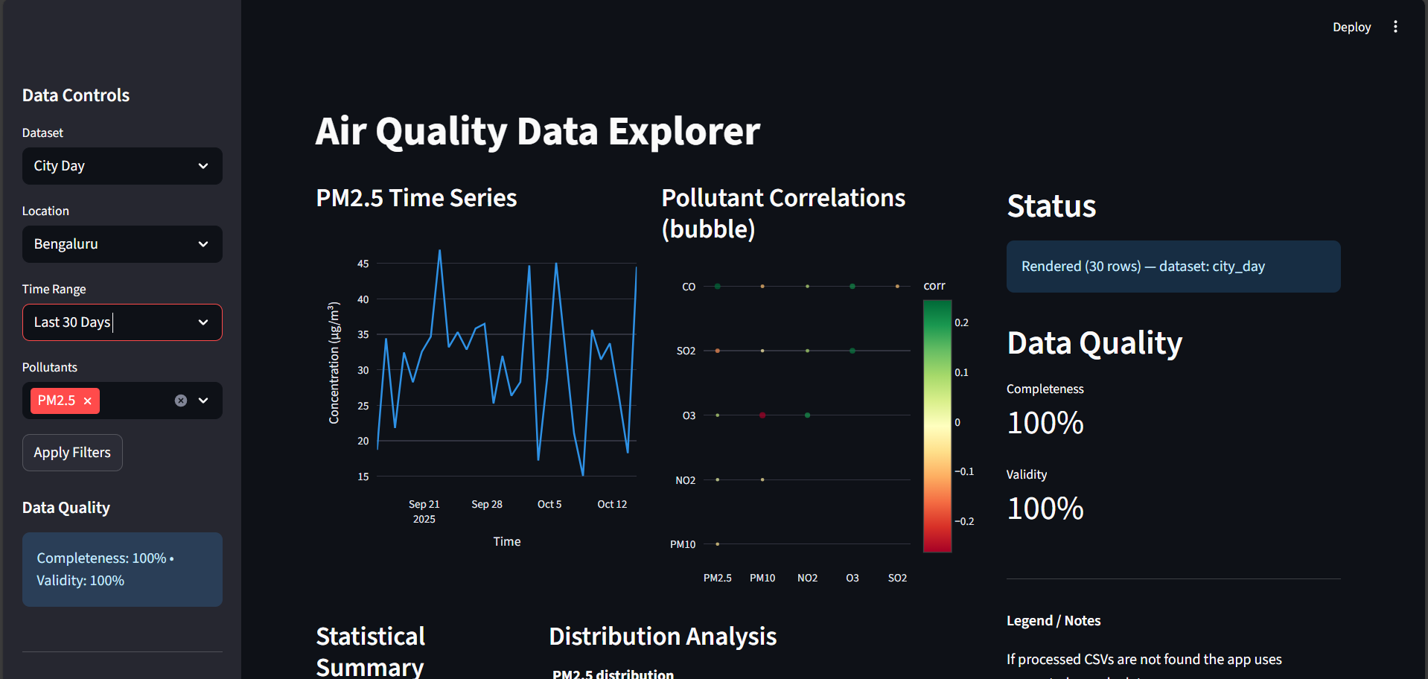
MILESTONE 1

Slide 10
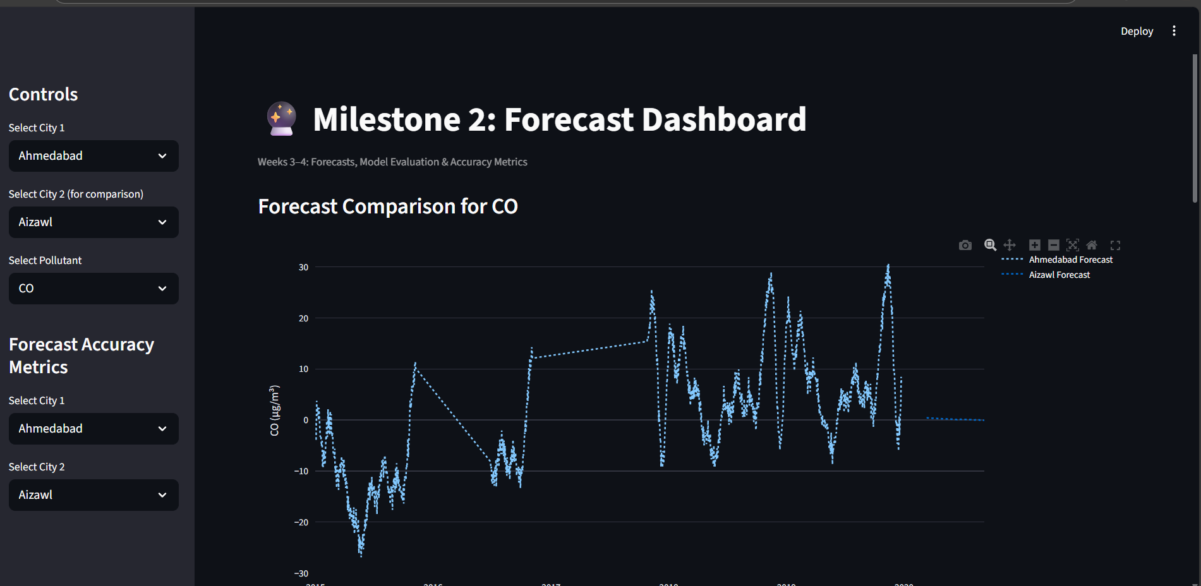
MILESTONE 2

Slide 11
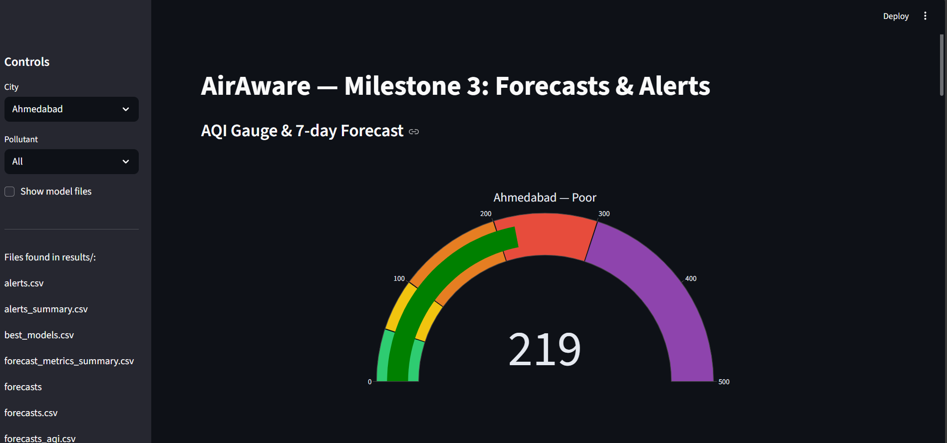
MILESTONE 3

Slide 12
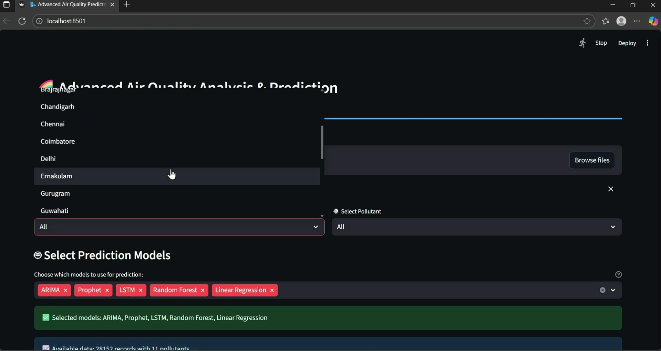
PROJECT FINIAL VIEW

Slide 13
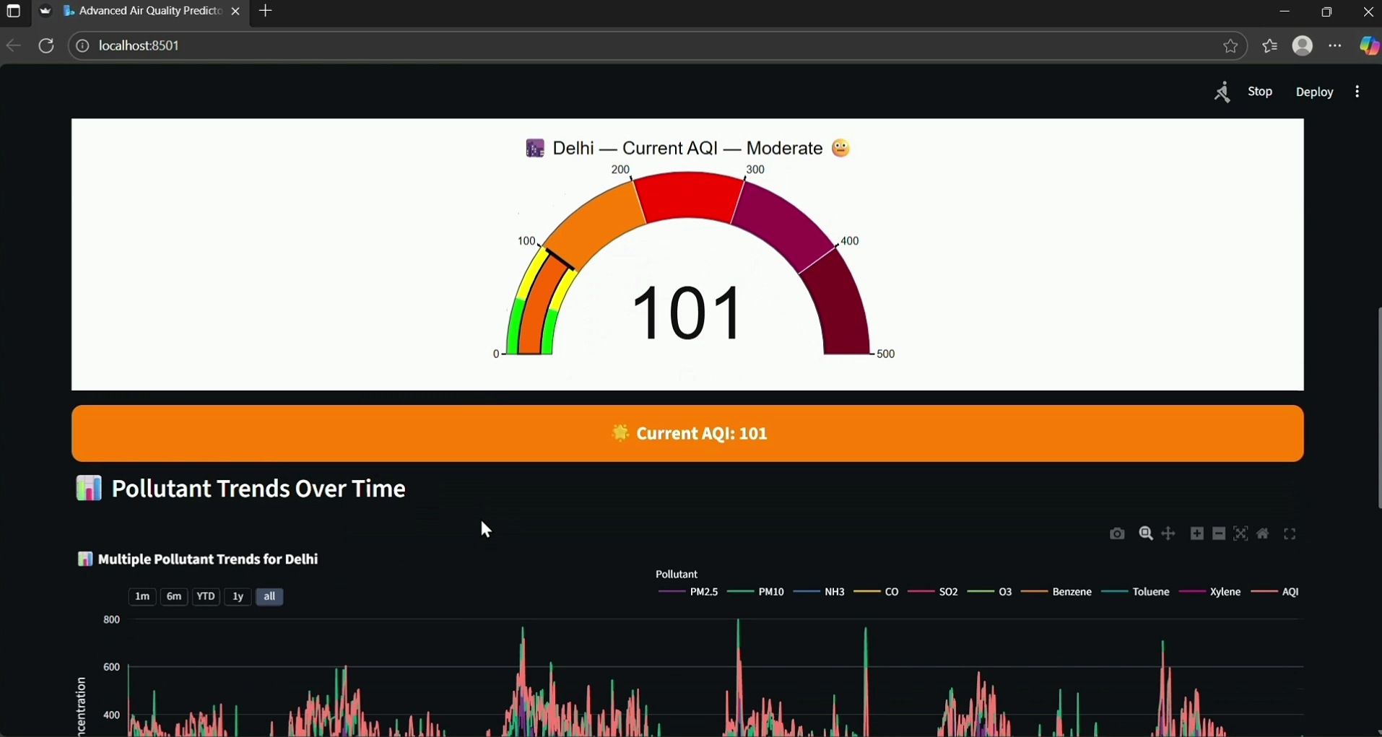
PROJECT FINIAL VIEW

Slide 14
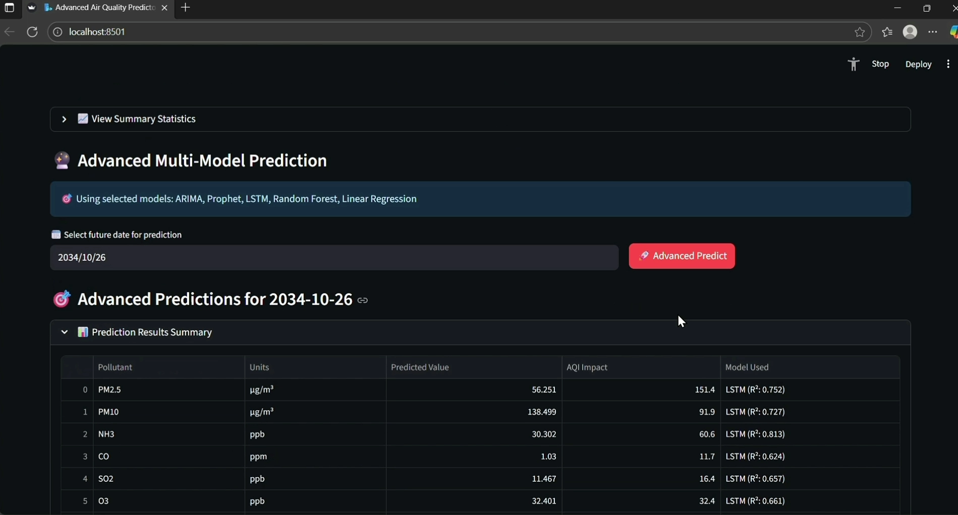
PROJECT FINIAL VIEW

Slide 15
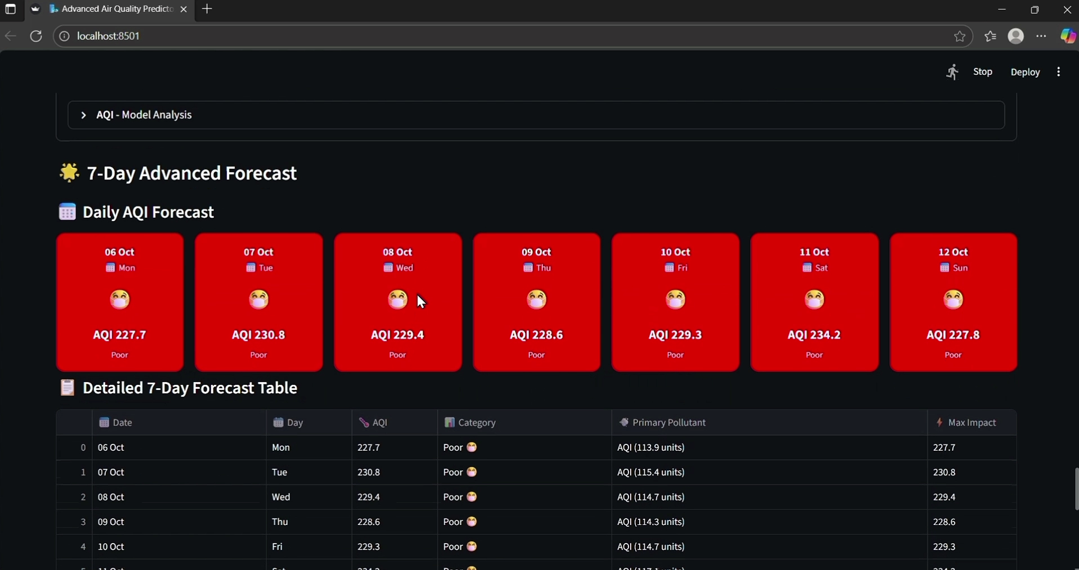
PROJECT FINIAL VIEW

Slide 16
FUTURE ENHANCEMENTS
Real-time government API integrations
Mobile application development
Geospatial mapping capabilities
Pollution source identification
Global scale deployment

Slide 17

CONCLUSION
Successfully delivered AI prediction platform
All project objectives achieved
Production-ready application
Significant environmental impact potential
Strong foundation for future enhancements

Slide 18

THANKYOU
Questions and answers
Thanks to Infosys Springboard

